Slide 1
4.7 Brownian Bridge(part 2)
報告人：李振綱

Slide 2
Outline
4.7.4 Multidimensional Distribution of the Brownian Bridge
4.7.5 Brownian Bridge as a Conditioned Brownian Motion

Slide 3






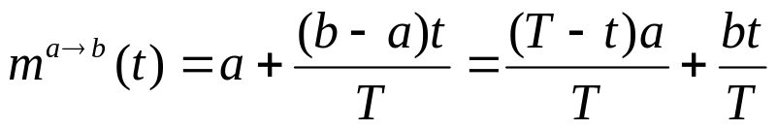
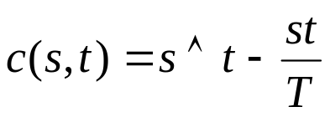

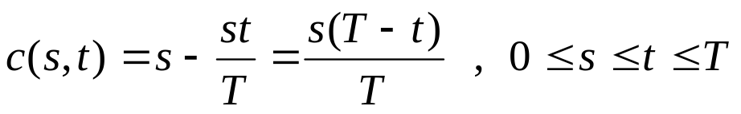


4.7.4 Multidimensional Distribution of the Brownian Bridge
We fix and and let denote the Brownian bridge from a to b on . We also fix . We compute the joint density of .
We recall that the Brownian bridge from a to b has the mean function
(P.176)
and covariance function
(P.176)
When , we may write this as
To simplify notation, we set so that .

Slide 4
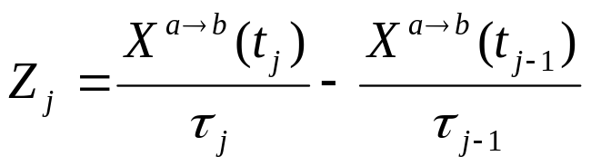




We define random variable
Because are jointly normal, so that
are jointly normal. We compute , and .
Brownian Bridge as Gaussian Process (4.7.2)

Slide 5
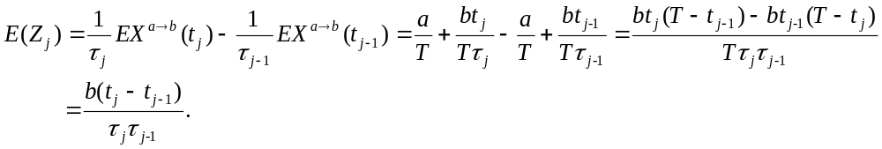


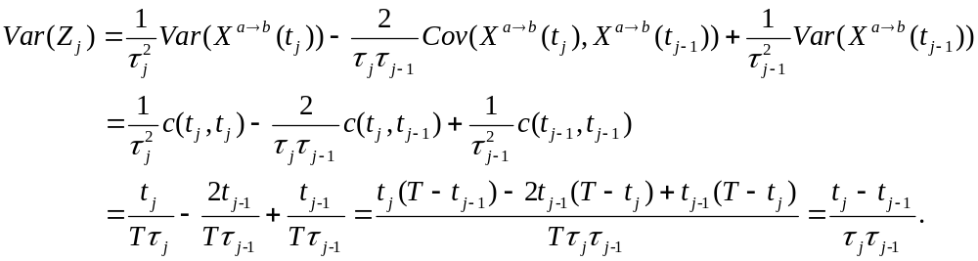
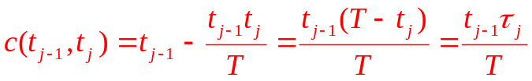
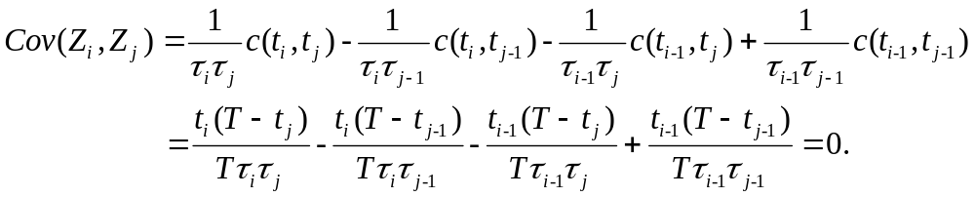


課本符號有錯
If X, Y are normal distribution
X,Y are independent Cov(X,Y)=0

Slide 6

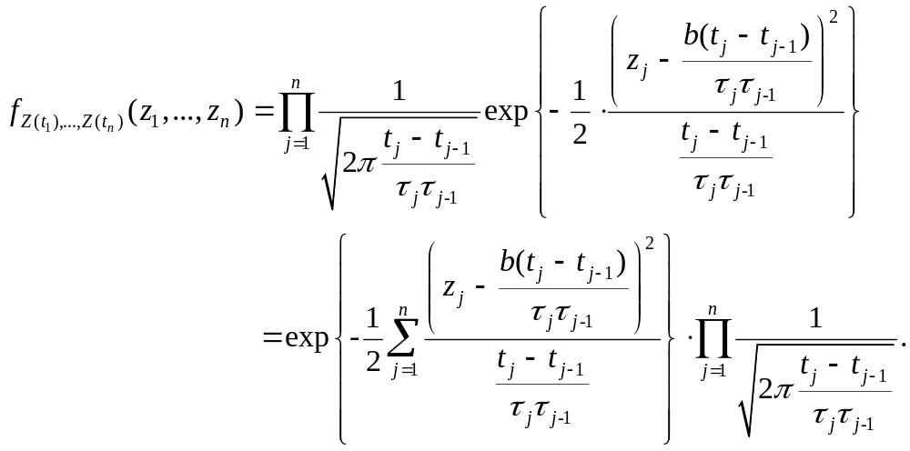
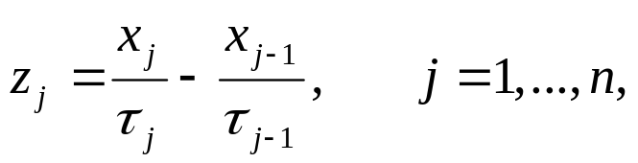
So we conclude that the normal random variable are independent, and we can write down their joint density, which is
we make the change of variables
mean
Variance
Variance
接下來把z的部份做變數變換

Slide 7

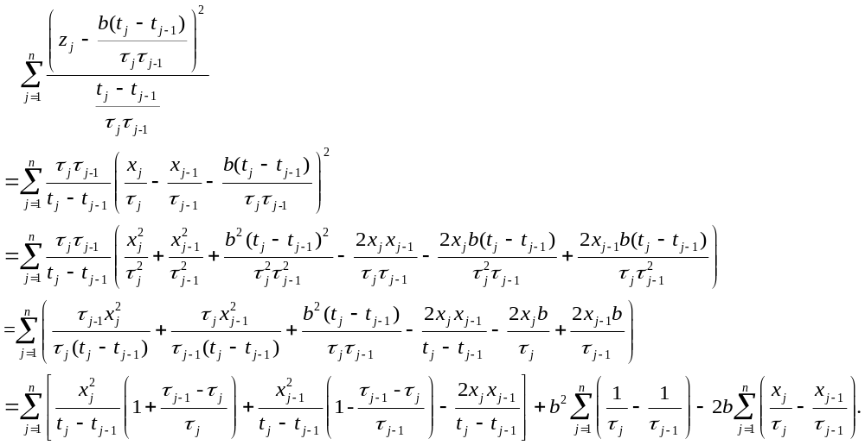

Where , to find joint density for . We work first on the sum in the exponent to see the effect of this change of variables. We have
Now

Slide 8
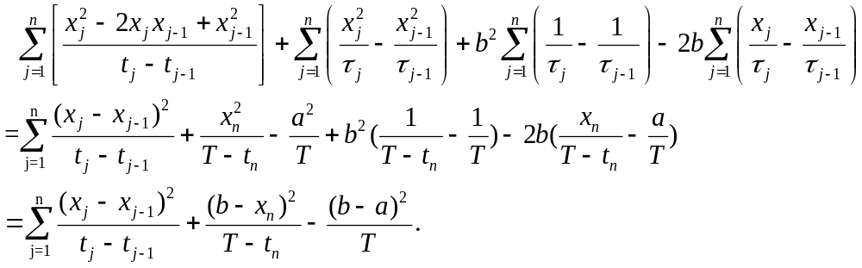
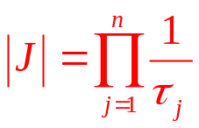
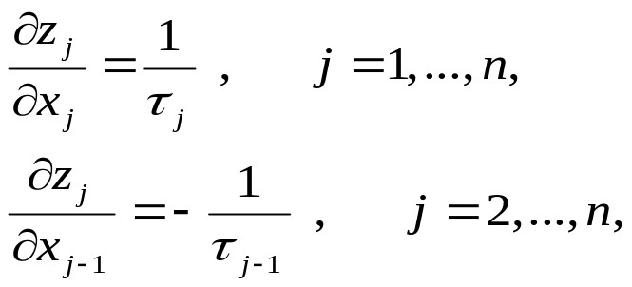
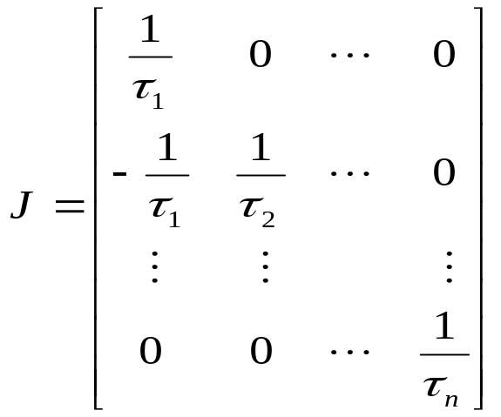
So this last expression is equal to
To change s density, we also need to account for the Jacobian of the change of variables. In this case, we have
and all other partial derivatives are
zero. This leads to the Jacobian matrix

Slide 9


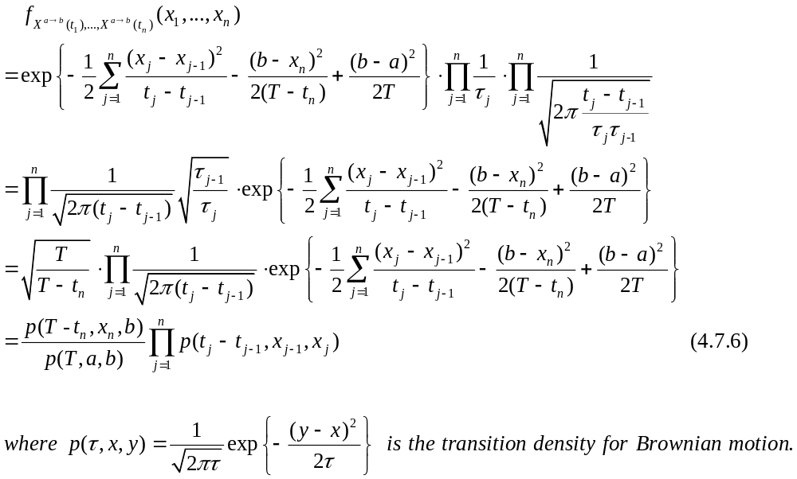

Whose determinant is . Multiplying by this
determinant and using the change of variables worked out above, we
obtain the density for ,
Ch3-5 P.108

Slide 10





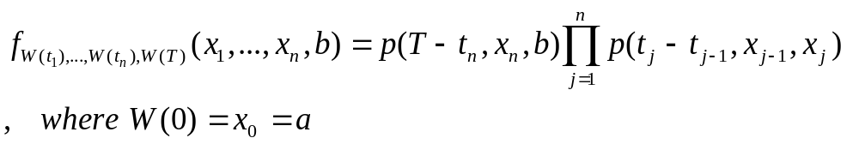










4.7.5 Brownian Bridge as a Conditioned Brownian Motion
The joint density (4.7.6) for permits us to give one more interpretation for Brownian bridge from a to b on .
It is a Brownian motion on this time interval, starting at
and conditioned to arrive at b at time T (i.e., conditioned on ).
Let be given. The joint density of
is
This is because is the density for the Brownian motion going from to in the time between and . Similarly, is the density for going from to between time and . The joint density for and is then the product
??

Slide 11

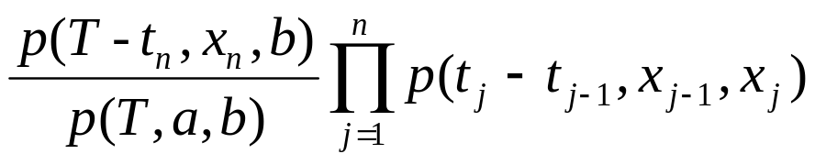

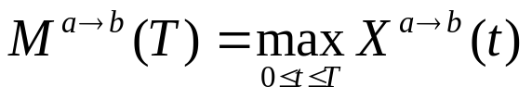
So, the density of conditioned on is thus the quotient
and this is of (4.7.6).
Finally, let us define
to be the maximum value obtained by the Brownian bridge from a to b on . This random variable has the following distribution.

Slide 12






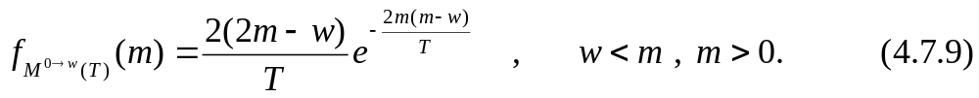







Corollary 4.7.7.
The density of is
Proof : Because the Brownian bridge from 0 to on is a Brownian motion conditioned on , the maximum of on is the maximum of on conditioned on . Therefore, the density of was computed in Corollary 3.7.4 and is
The density of can be obtained by translating from the initial condition to and using (4.7.9). In particular, in (4.7.9) we replace by and replace by . This result in (4.7.8).

Slide 13
Thank you for your listening!!

